Slide 1

Uniform Distribution System (UDS)
Transforming corporate uniform management through intelligent automation

Slide 2





The Uniform Challenge
How do uniforms reach employees today?
Fragmented Channels
Manual Tracking
Communication across various platforms like email, phone and WhatsApp leads to disorganization.
Relying on spreadsheets for tracking is prone to errors and inefficiencies.
Excessive Follow-ups
Scalability Issues
Constant manual coordination consumes valuable time and resources.
Managing uniforms across multiple locations and vendors is increasingly difficult.
This is precisely where UDS transforms the game. UDS is designed so every feature creates value for at least one stakeholder — and friction for none

Slide 3
What is UDS?
B2B2C SaaS Platform
Single Source of Truth
Zero Fragmentation
Unified workflow connecting all stakeholders
From request to delivery to payment
One platform replacing multiple tools
"Think of UDS as the operating system for corporate uniforms—streamlining what was once chaotic into something beautifully simple."

Slide 4



The Three-Way Problem
Before introducing solutions, let's understand the pain points experienced by each stakeholder in the current system.
Employees Ask
Employers Wonder
Vendors Face
"I just need my uniform—why is it so complicated?"
"Why does something operational consume so much management time?"
"Orders arrive constantly, but nothing is standardised."
Manual request processes
No delivery visibility
Endless follow-ups
Approval bottlenecks
Zero spend visibility
Policy leakage risks
Scattered demand patterns
Manual fulfillment chaos
Delayed payments

Slide 5

The UDS Philosophy
Our Core Belief
Designing for Triple Success
"Every stakeholder should win—without creating extra work for anyone else."
Rather than optimising for just one party at the expense of others, UDS orchestrates a single, automated workflow that benefits employees, employers, and vendors simultaneously.
The result? A system where efficiency gains are shared, frustrations disappear, and everyone experiences genuine improvement in their daily operations.
Employer Control
Maintain oversight without extra administrative burden.
Employee Experience
Vendor Efficiency
Delight staff with seamless, low-effort workflows.
Streamline partners to reduce friction and cost.
This unified approach eliminates trade-offs and creates a genuinely collaborative ecosystem.

Slide 6



The Unified Stakeholder Experience
Employee: Effortless Ordering
Employer: Centralized Control
Vendor: Streamlined Fulfillment
Employees simply request uniforms via WhatsApp or the web portal, selecting size, role, and location. UDS handles eligibility, approvals, and delivery, providing:
The Employer Dashboard provides comprehensive oversight without manual effort, enabling:
Vendors benefit from an organized system that transforms order management:
Configurable Workflows & Eligibility
Budget Monitoring & Management
Branch-Wide Visibility
Consolidated Demand
Clear SKU Details & Quantities
Company Segregation
Instant Acknowledgement
Real-Time Tracking
Zero Follow-Ups
Eliminates inter-departmental coordination and chasing approvals.
Automated logistics ensure timely, accurate fulfillment, reducing errors and complexity.
This unified platform seamlessly connects all stakeholders, turning individual needs into a synchronized, efficient ecosystem where everyone wins.

Slide 7















Core Features
UDS delivers comprehensive capabilities tailored to each stakeholder.
Employee Features
Employer Features
Vendor Features
Multi-Channel Requests
Centralized Dashboard
Order Consolidation
Order via WhatsApp or web portal.
Company-wide operational visibility.
Streamlined procurement demand.
Real-Time Tracking
Workflow Automation
Inventory Management
Track orders from dispatch to delivery.
Faster approvals, enforced policies.
Real-time stock for better planning.
Transparent Status
Budget Control
Logistics Automation
Full visibility on approval & fulfillment.
Monitor and control budgets & spending.
Automated shipments.
Secure Access
Reporting & Analytics
Financial Workflow
Guaranteed role-based secure access.
Key metrics on requests & spend.
Clean reconciliation & faster processing.

Slide 8

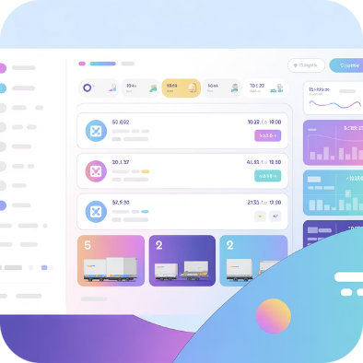


The Technology Foundation
UDS integrates seamlessly with enterprise systems and external platforms, creating a robust technology backbone that operates reliably at scale.
WhatsApp Business APIs
Logistics Partners
Finance Workflows
Connected with Shiprocket, Eshipz, ClickPost for nationwide delivery coverage
Direct integration for mobile-first employee order with instant messaging capabilities
Bridges operations and finance by embedding PR-PO compliance.
This ensures clean invoicing, accurate GRNs
All data flows in real time across integrated systems—eliminating manual reconciliation entirely and ensuring accuracy at every touchpoint.

Slide 9









Tech Stack
Key Technologies
Front end
React Framework
TypeScript
CSS
Back end
REST API (114 APIs)
Node.js
Repository
GitHub
Database
MongoDB
Integration Email
SMTP Nodemailer
Security
OAuth (Role-based access)
API auth helpers

Slide 10
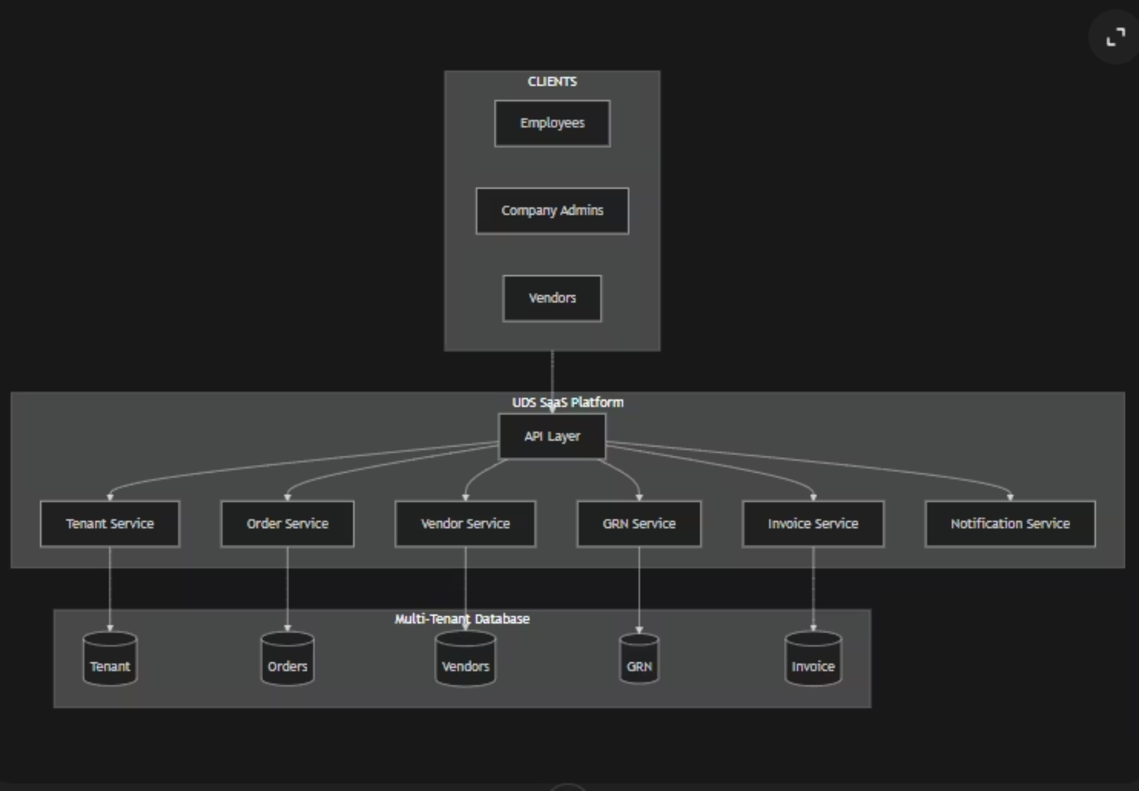
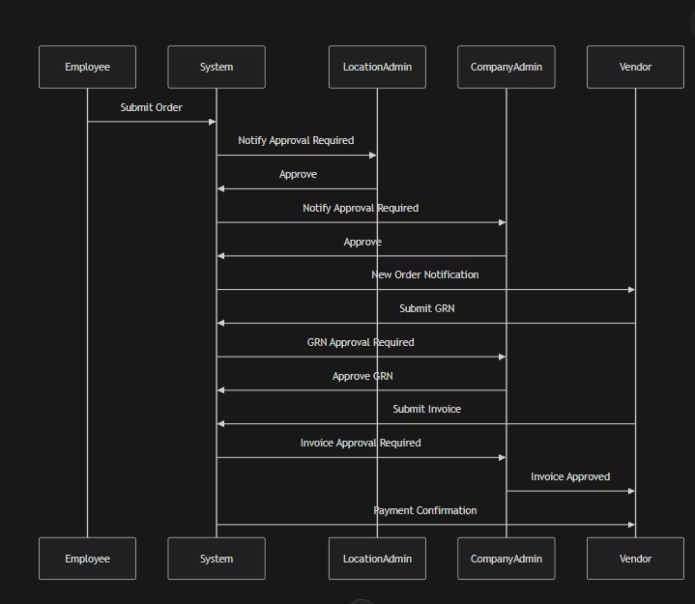
E2E FLOW
Notification workflow

